Slide 1



DATA SCIENCE / DATA ANALYTICS
OPTIMIZATION OF MACHINE DOWNTIME
BY-
LEEBAN SESARIO S
Batch - 91

Slide 2
Contents
Business Objective
Business Constraints
Project Architecture - Data Flow Diagram
Data Collection
Exploratory Data Analysis
Data Visualization
Notes:
Change

Slide 3
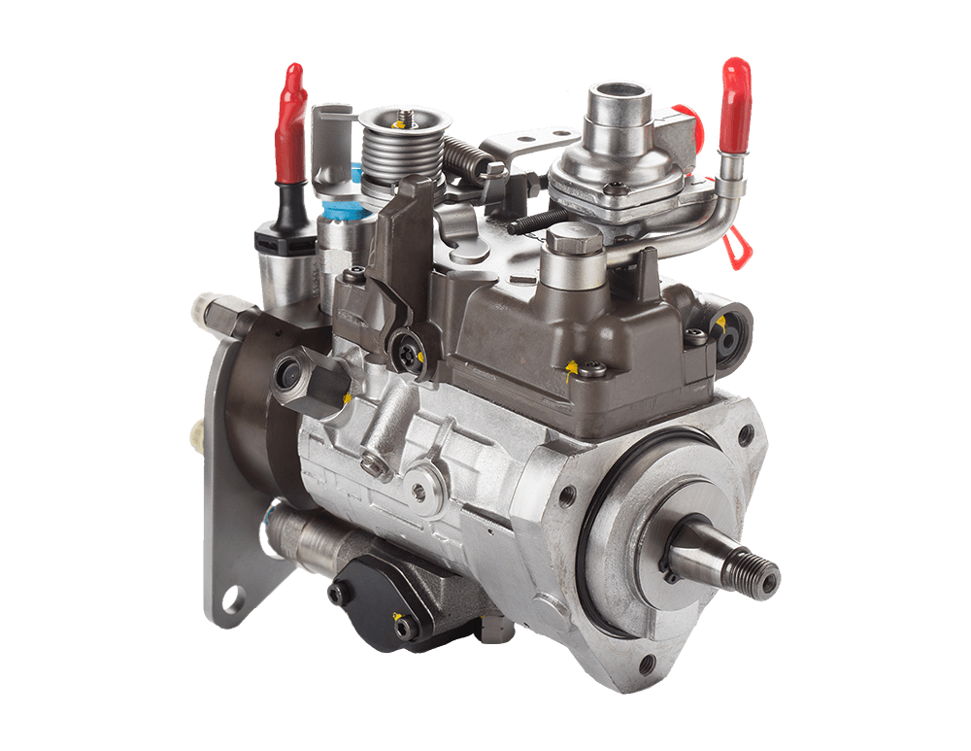
Business Problem
Client: One of the leading vehicle fuel pump manufacturers. These pumps are used to take fuel as input and push fuel as output at a high velocity. More the velocity, more is the speed at which vehicle will move.
Business Problem: Machines which manufacture the pumps. Unplanned machine downtime which is leading to loss of productivity.
Business objective: Minimize unplanned machine downtime.
Business constraint: Minimize maintenance cost.
Business success criteria: Reduce the unplanned downtime by at least 10%
Economic success criteria: Achieve a cost saving of at least $1M"

Slide 4
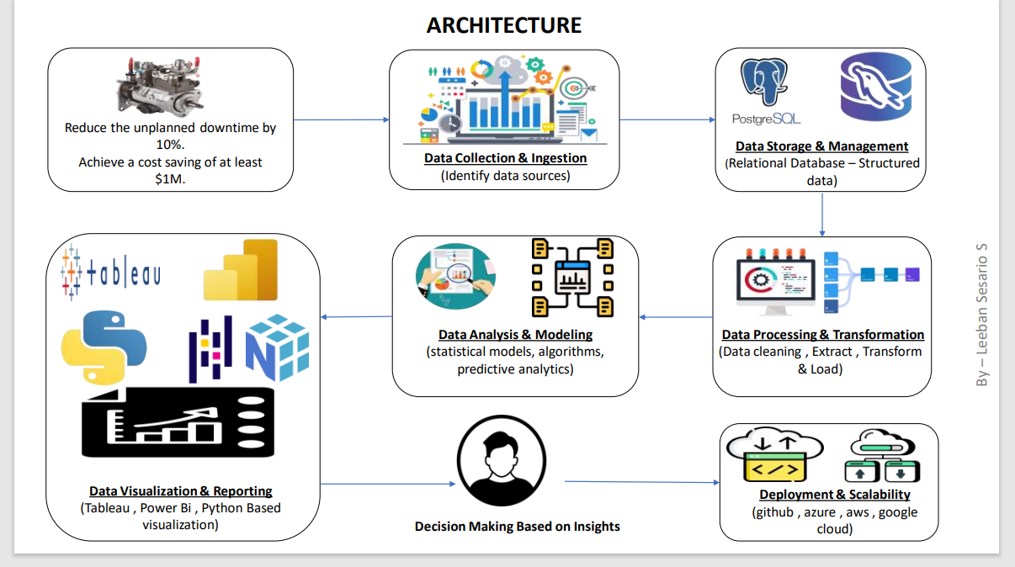
Project Overview and Scope
The project aims to analyse and minimize unplanned machine downtime in a fuel pump manufacturing unit. The company is experiencing losses due to unexpected machine failures, leading to reduced productivity. By leveraging data analytics, SQL, Python, and Power BI, the goal is to identify the key factors contributing to machine downtime and optimize maintenance schedules to reduce unexpected failures.
Project Scope:
1. Data Collection & Processing: Gather machine logs, sensor readings, and downtime
records from manufacturing units.
2. Exploratory Data Analysis (EDA): Identify patterns, correlations, and key downtime causes.
3. Predictive Maintenance Analysis: Determine which factors contribute most to machine failures.
4. Data Visualization: Use Power BI dashboards to track downtime trends, machine health, and maintenance efficiency.
5. Optimization Strategies: Recommend maintenance scheduling improvements based on findings.

Slide 5

Data Dictionary
Column Name | Data Type | Description | Example Value
Machine_ID | Integer | Unique identifier for each machine | 1023
Timestamp | Datetime | Date and time when the data was recorded | 2025-03-15 14:23:00
Downtime_Status | Boolean | Indicates if the machine is in downtime (1) or running (0) | 1
Downtime_Duration | Float | Duration of downtime in minutes | 45.5
Air_System_Pressure | Float | Pressure level in the air system (PSI) | 75.2
Coolant_Pressure | Float | Pressure level in the coolant system (PSI) | 60.4
Hydraulic_Pressure | Float | Pressure in the hydraulic system (PSI) | 85.7
Temperature | Float | Machine operating temperature in Celsius | 75.3
Spindle_Vibration | Float | Vibration level of the spindle in mm/sec | 0.15
Tool_Vibration | Float | Vibration level of the cutting tool in mm/sec | 0.22
Torque | Float | Torque applied on the spindle (Nm) | 120.5
Voltage | Float | Voltage supplied to the machine (V) | 230
Machine_Utilization | Float | Percentage of time the machine was in use | 85.6
Maintenance_Flag | Boolean | Indicates if maintenance was performed (1) or not (0) | 1
Failure_Type | String | Category of machine failure | "Overheating"
Production_Loss | Float | Estimated production loss in USD due to downtime | 12000
Operator_ID | Integer | Unique identifier for the machine operator | 5007
A data dictionary defines the structure, format and meaning of each attribute in the data set.
Timestamp - is crucial for
time-series analysis and trend detection.
Downtime-flag & Downtime
Duration -
are primary target
variables for predicting failures.
Sensors readings -
(pressure ,temp , vibration) are key features for identifying patterns leading to downtime.
Categorical variables -
(Failure-type , Maintenance-action) help root cause analysis.

Slide 6
Exploratory Data Analysis [EDA]
Statistical Insights
Business Insights
Downtime Distribution -
The majority of machine downtimes occur during peak operational hours.
A high frequency of unplanned downtimes is observed in machines with prolonged operational hours without scheduled maintenance.
Correlation Analysis -
Strong correlation found between spindle vibration levels and machine failures.
Coolant pressure variations have a direct impact on machine performance, leading to potential failures.
Time-Series Trends -
Seasonality in failures detected, with increased downtime occurrences in certain months due to operational load.
Predictive maintenance models indicate a potential 20% reduction in downtime if corrective actions are implemented.
Machine Failure Clusters -
Cluster analysis highlights specific machines with repeated breakdowns.
Machines operating at higher torque and temperature ranges show a 30% higher failure probability.
Cost Impact -
An estimated $1M savings can be achieved by reducing downtime by at least 10%.
Energy consumption spikes before failures indicate potential power inefficiencies contributing to machine failures.
Operational Efficiency -
Implementing predictive maintenance can significantly reduce unexpected downtimes and improve efficiency.
Proactive scheduling of maintenance can optimize machine utilization and reduce production bottlenecks.
Cost Optimization -
Reducing unplanned downtime directly impacts profit margins by improving production throughput.
Optimized maintenance scheduling reduces operational costs and minimizes unnecessary repairs.
Risk Mitigation -
Real-time monitoring of machine parameters allows for early fault detection.
Reducing high-risk machine failures prevents cascading impacts on production lines.
Resource Allocation -
Investing in sensor-driven monitoring and AI-powered analytics enhances machine lifespan and minimizes human intervention.
Shifting maintenance strategies from reactive to predictive and preventive models increases operational reliability.
Notes:
EDA is used for seeing what the data can tell us before the modeling task.
Change

Slide 7

Data Preprocessing
Data Collection –
Data was gathered from machine sensors and logs, including varibles like ( coolant pressure, Temperature, Performance,etc)
The dataset spans multiple months, covering machine downtime trends across different years.
2. Handled missing values –
import necessary libraries ( num py , pandas)
Load the data sets (df = pd.read_excel("Machine Downtime.xlsx"))
3.Converted data types appropriately –
Check for missing values
Impute missing numerical values
Fill categorial missing values
4. Data Cleaning –
Outlier detection was performed on parameters like spindle speed, pressure & temperature
using ( z – score Analysis , IQR).
Duplicate records were indentify and removed.
5. Feature Engineering –
Rolling averages of pressure/temperature for trend detection.
Lag features to predict future failures.
Difference metrics to track sudden changes in sensor values.
6. Data Integration –
Merged machine logs with maintenance records to correlate failure causes.
Integrated structured SQL tables with unstructured log data for comprehensive analysis.
7. Data Splitting –
Split the dataset into:
- Training data ( used for predictive modeling)
- Validation/test data ( used for model evaluation)
8. Data Storage & Visualization –
Stored in an SQL database for structured querying.
Used power Bi dashboards for visual trend analysis of downtime factors.
.
Notes:
Keep observations

Slide 8

Data Visualization
1. Downtime Trend Over Time Visualization Type: Line Chart
Purpose: To track machine downtime occurrences over time.
X-axis: Timestamp (Date/Time)-
Y-axis: Downtime Duration (minutes)
Helps identify seasonal or periodic trends in machine failures.
2. Downtime Distribution by Machine Visualization Type: Bar Chart
Purpose: To see which machines have the highest downtime.
X-axis: Machine ID
Y-axis: Total Downtime (minutes)
Helps prioritize maintenance schedules.
3. Correlation Heatmap (Feature Relationship) Visualization Type: Heatmap
Purpose: Identifies relationships between sensor data and downtime.
High correlation between parameters (e.g., high spindle vibration → increased downtime).
Helps select features for predictive models.
4.Boxplot of Sensor Readings During Downtime Visualization Type: Boxplot
Purpose: Detects anomalies in sensor values during downtime.
Example: If coolant pressure is consistently low during failures, it could be a predictive indicator.
5. Failure Type Distribution Visualization Type: Pie Chart
Purpose: Shows the proportion of different failure types.
Example: Mechanical failures (60%) vs. Electrical failures (40%). Helps focus on the most frequent issues.
6. Machine Health Dashboard (Power BI/Tableau)
KPI Cards: Total downtime, average downtime per machine, cost impact.
Gauge Charts: Show real-time machine health.
Filters: Machine ID, failure type, and time range.
Notes:
Add graphical

Slide 9


